Slide 1

UNIVERSITY MANAGEMNT SYSTEM

Slide 2
Group members-
Vedant Agrawal 19BCE10057
Samyak Jain 19BCE10066
Shikhar Pandey 19BCE10036
Subhasish Das – 19BCE10122
FACULTY ADVISER AND GUIDE-Dr. Nitish Andola

Slide 3
INTRODUCTION:
These days, automation and computerization have made things easier. Our project ,University management system aims to manage student, semester, faculties, and examinations digitally. This cloud based university management system software manages all activities of the university efficiently and precisely.
It helps individuals, processes, and communities to communicate seamlessly throughout the campus in an efficient environment that provides appropriate services and personalized educational experiences.

Slide 4
EXISTING WORK WITH LIMITATIONS-
Almost every university have their student and faculty management system where the data of student are kept in a organised manner and support many functions such as online payment, messaging to proctor, results, etc.But one thing most of them lack is Student's record of activities ,projects and certifcates of extra cirricular activities.
And also many universities use third party platform for their students to submit their assignments and work. The marks and record of which is eventually to be keppt on their website.

Slide 5
PROPOSED WORK AND METHODOLOGY-
Many institutions use old techniques of work such as offline admission forms , course registration , roster attendance, etc which increase paperwork and creates bundles of data which will be difficult to search and access later and is also not very compatible.
These issues can be resolved when data is stored in computational form.
In this project we are using various type of modules available to manage faculties, Students, attendance, slots, etc. We will also generate reports for Students.

Slide 6
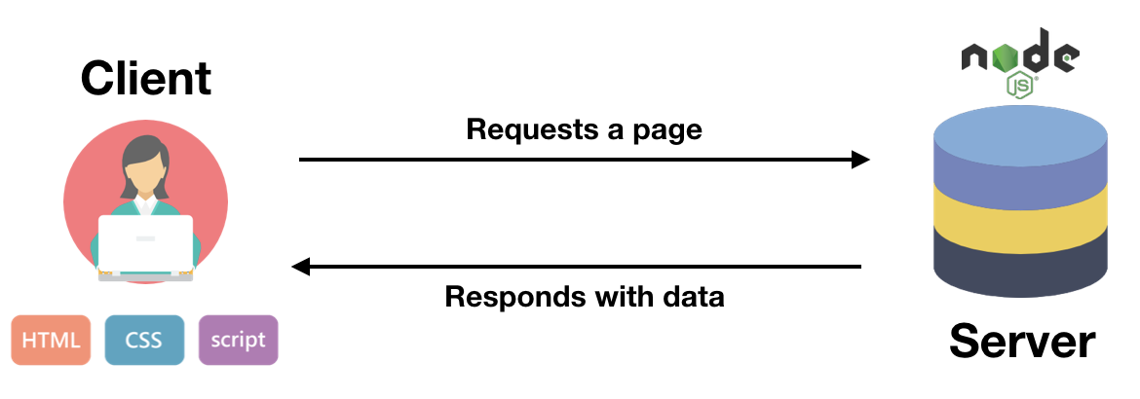
We will make the design of the website(front end development) using HTML ,CSS ,etc.
And javascript to make site interactive and responsive i.e, to work on user requests .(To show or hide data with a click of a button, to make drop down menu, to make a login and logout, to access information, etc).
We will store the data of students in datatbase and show it on the front end of the site.
Once all developments are done, we proceed to the Testing phase, where we will test our website. For eg-that it works and loads on other browsers also,etc

Slide 7
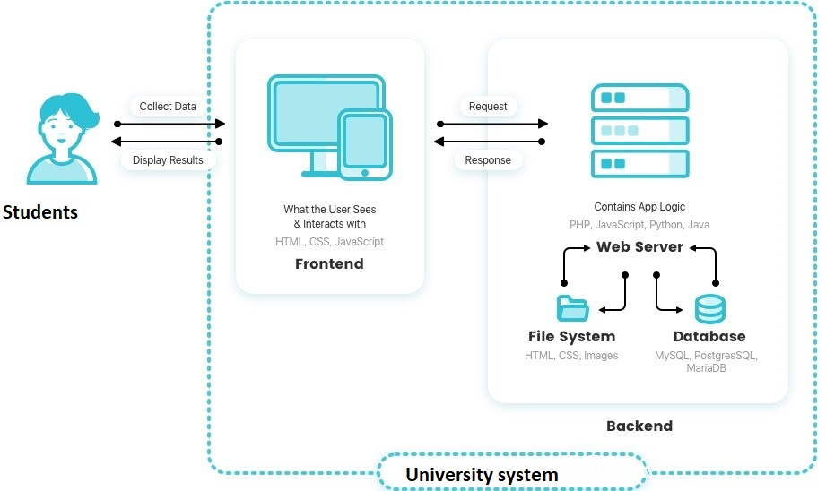
Architecture Diagram:

Slide 8
REAL TIME USAGE-
Attendance management-Teachers won't have to carry thick registers to roster attendance and Students will be able check their attendance.
Students can see their examination reports online.
University Calendar and dates of occasions will be available.
Employee management
Finance Management-Payment and receipt information will be available.
Messaging/Email Management- You can send message to your faculty.
Online Admissions Management

Slide 9
NOVELTY:
Projects like these are have made earlier but the one common thing most of them lacked is that they did not have student assignment management system.
Many institution use third party website and softwares for assigning the Quizes and assignments like Google classroom and Moodle.
Students and teachers have to switch from platform from platform to check for their assignment and feed or see marks.
That is why we will develop and assignment section in our website.

Slide 10
HARDWARE AND SOFTWARE REQUIREMENTS-
Knowledge and skills of web development and database management required such as PHP, CSS, HTML,JAVASCRIPT,JQUERY MySQL, etc.

Slide 11

THANK YOU

